Slide 1
MOOCs, Past, Present, and Future
Dr. Charles Severance
www.dr-chuck.com
Notes:
Past: Sunrise / TV / Syncomat / CB2K / Sakai / LTI / OER
Present: Crème rises / Competition / Looked @ Python MSUI / BSI / Automation / Scale / Specialization further scale
I am better online than in class – student motivation / weariness

Slide 2
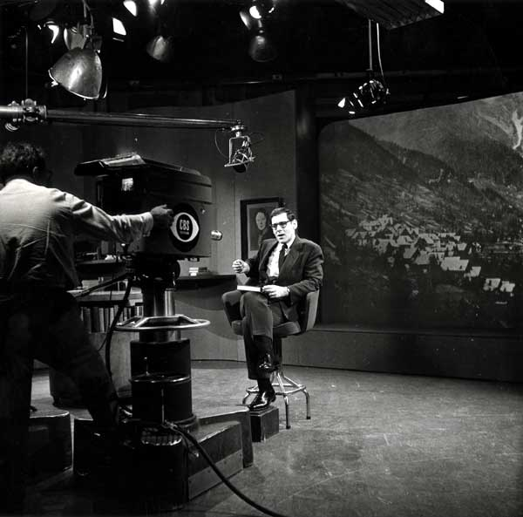
Sunrise Semester
New York University
CBS – 6:00AM
1957-1982
120K students
Precursor to PBS
https://en.wikipedia.org/wiki/Sunrise_Semester

Slide 3

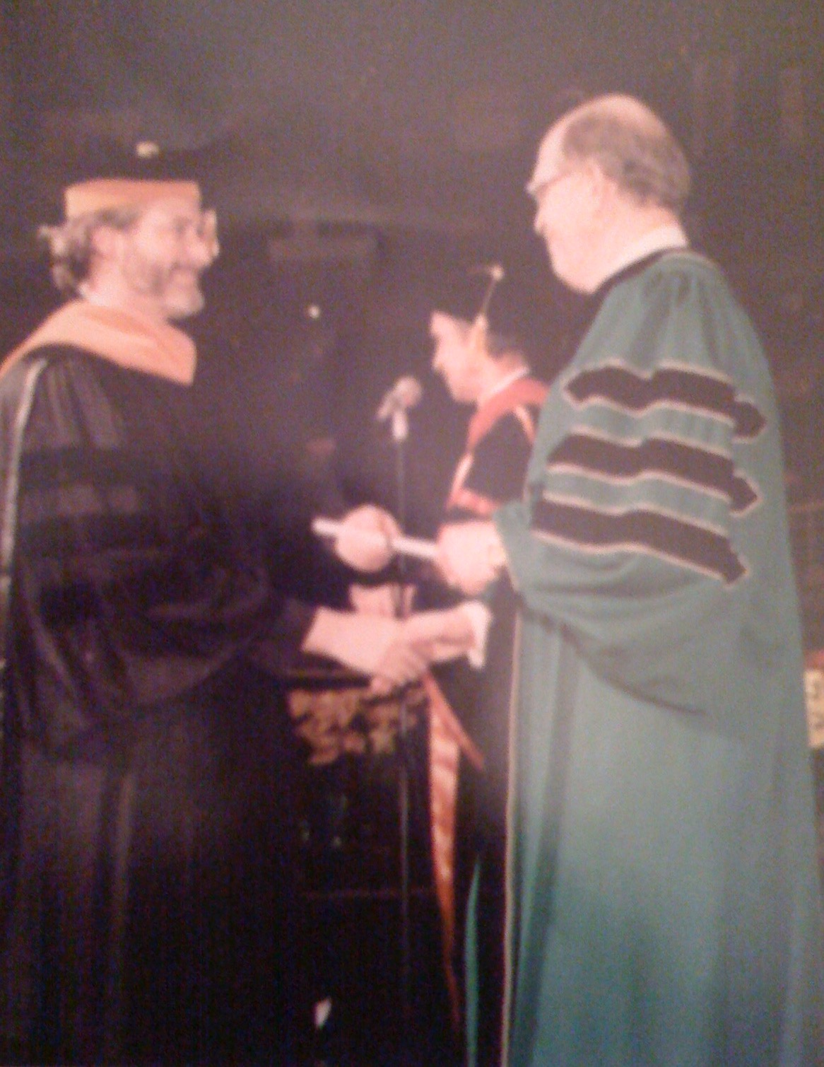
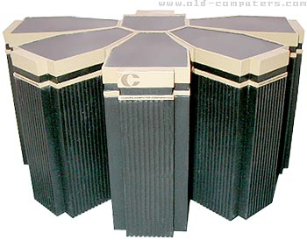
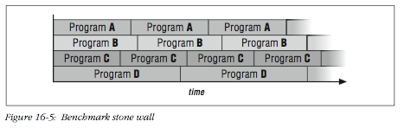
1996

Slide 4
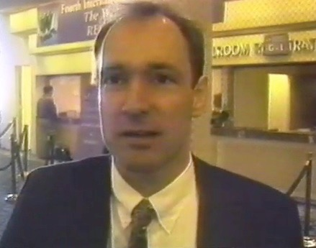
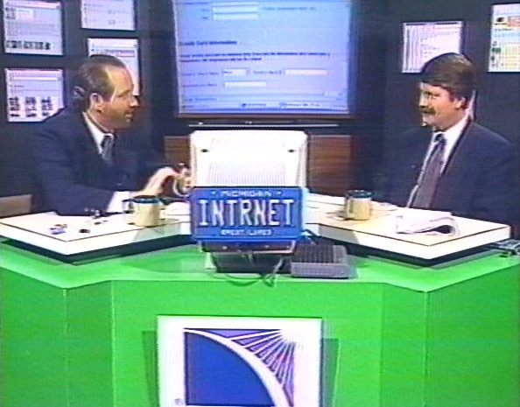
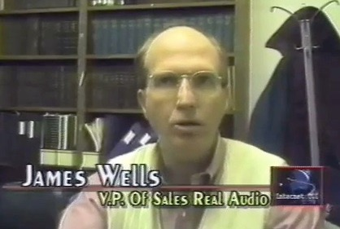
1996

Slide 5
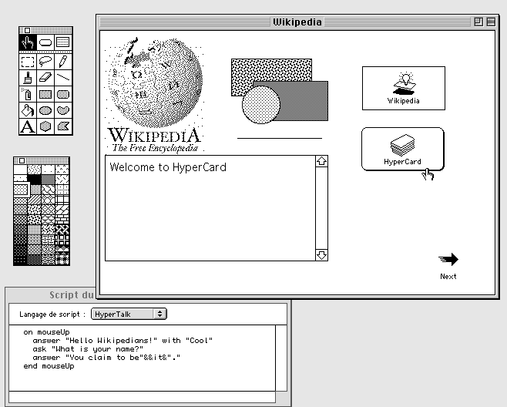
1996

Slide 6
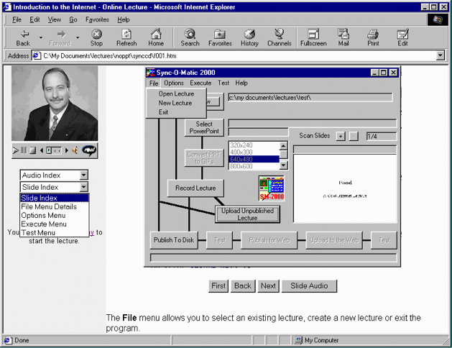
1996

Slide 7
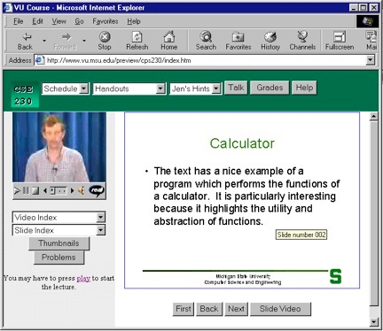
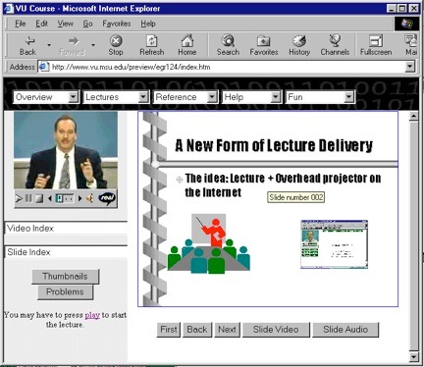
Sync-O-Matic
www.syncomat.com
1997

Slide 8
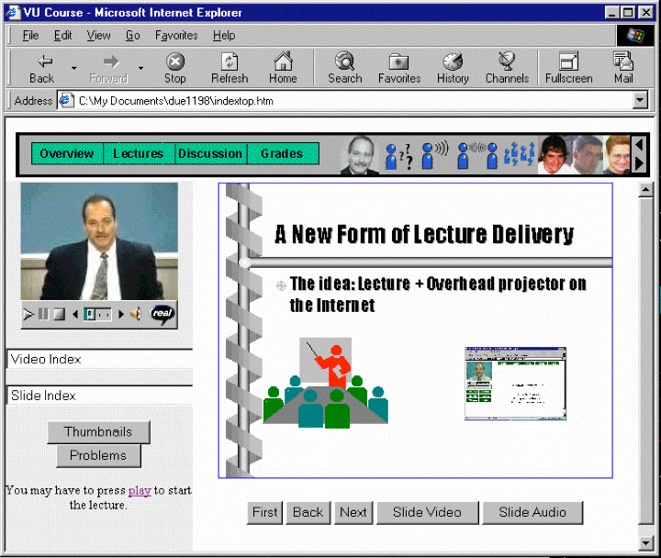
Title: Using Asynchronous, Web-based, Video to Humanize Distance Education
1998

Slide 9
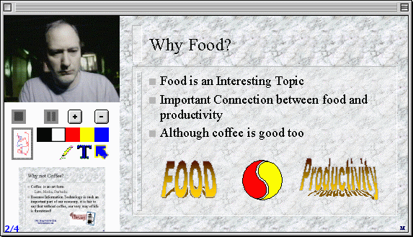
2000
http://www-personal.umich.edu/~csev/csev/projects/cb2k/index.htm

Slide 10

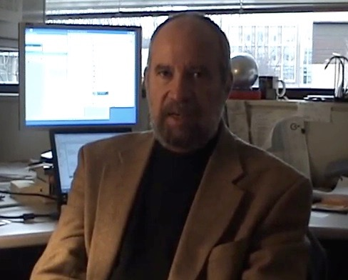
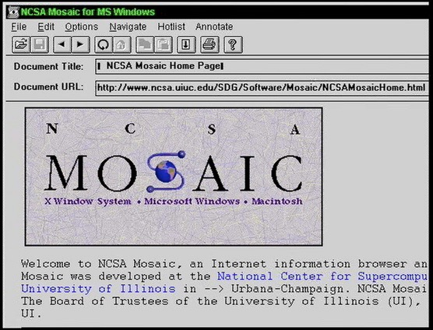
2003

Slide 11

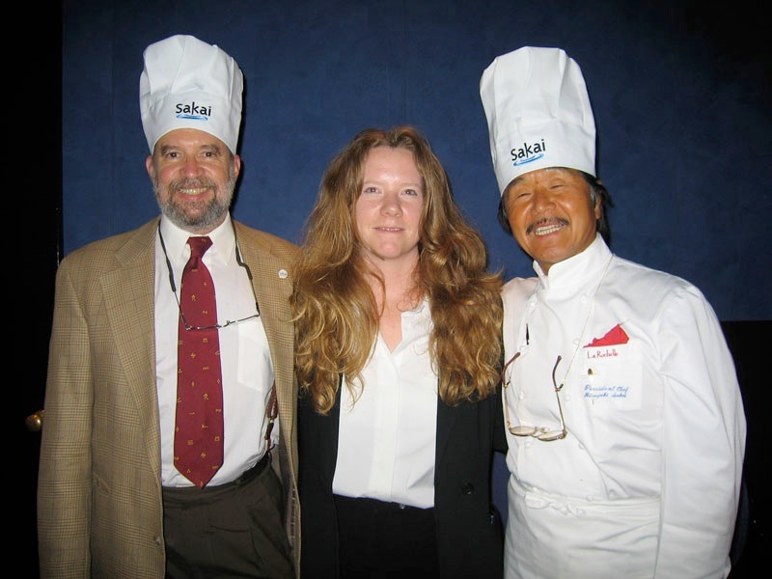
2004

Slide 12
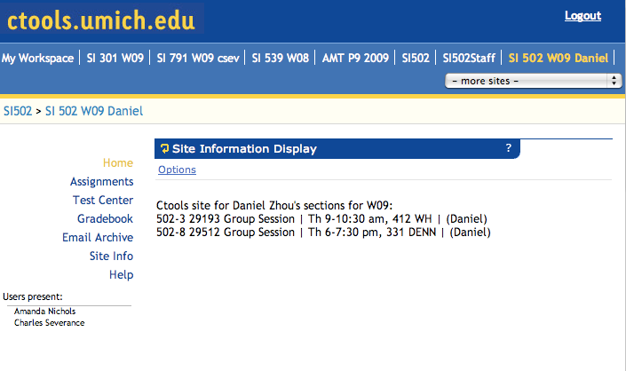

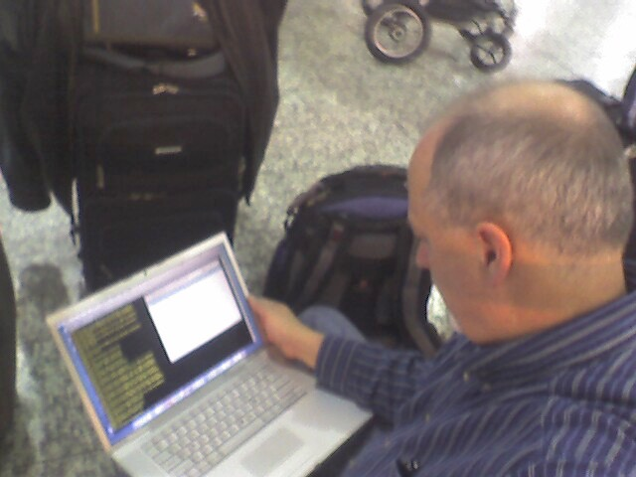
2007

Slide 13
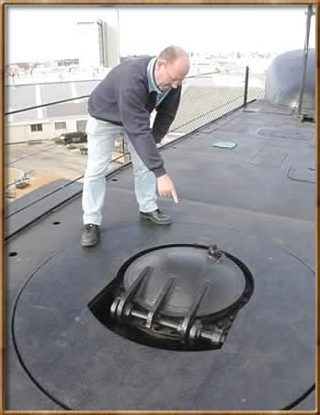
2008

Slide 14
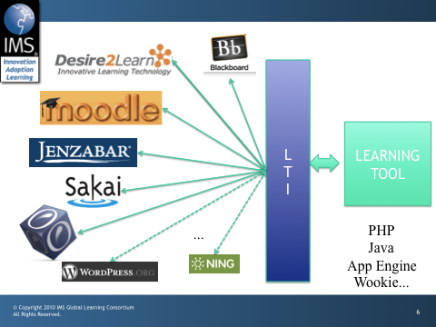

Slide 15
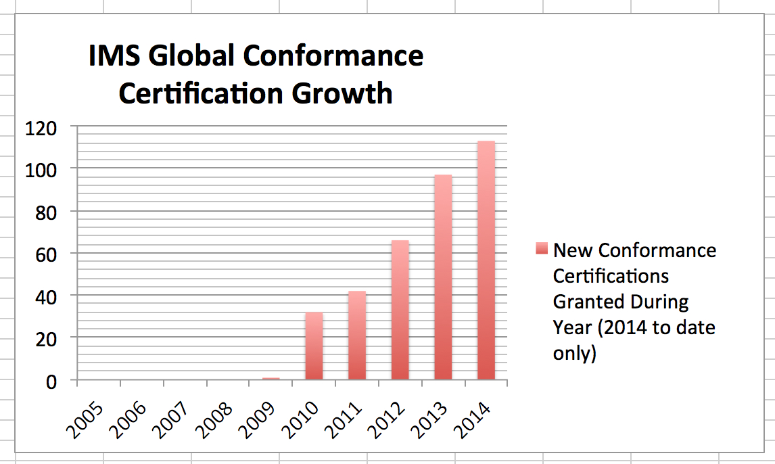

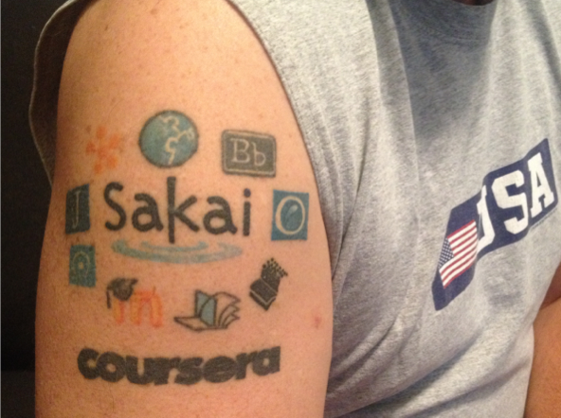


Slide 16

































2011

Slide 17

2012

Slide 18
Internet: TCI
Nuthin’ But Net

Slide 20
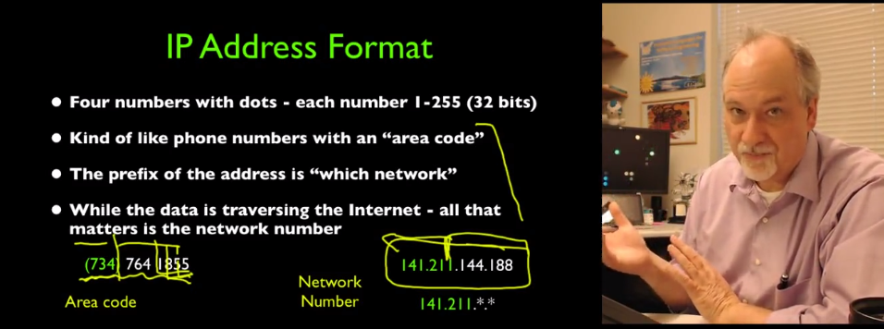
2012

Slide 21
N=4701
http://www.dr-chuck.com/coursera/insidetheinternet/2012-001/maps/where.html

Slide 22
Megan (UK)
Karen (NC)
Mazen (Egypt)
Sue (CA)
Susan (PA)
Mauro (Italy)

Slide 23
New York, Los Angeles, Ann Arbor, Chicago, Washington DC, Memphis, Seattle, Seoul, Barcelona, London, Mexico City, Amsterdam, Manila Melbourne, Perth...
http://office-hours.dr-chuck.com
Notes:
Since I have a very active travel schedule, I decided to hold office hours in the major cities I have visited. I have held office hours in over 40cities and in each location somewhere between two and 15 students show up.

Slide 24
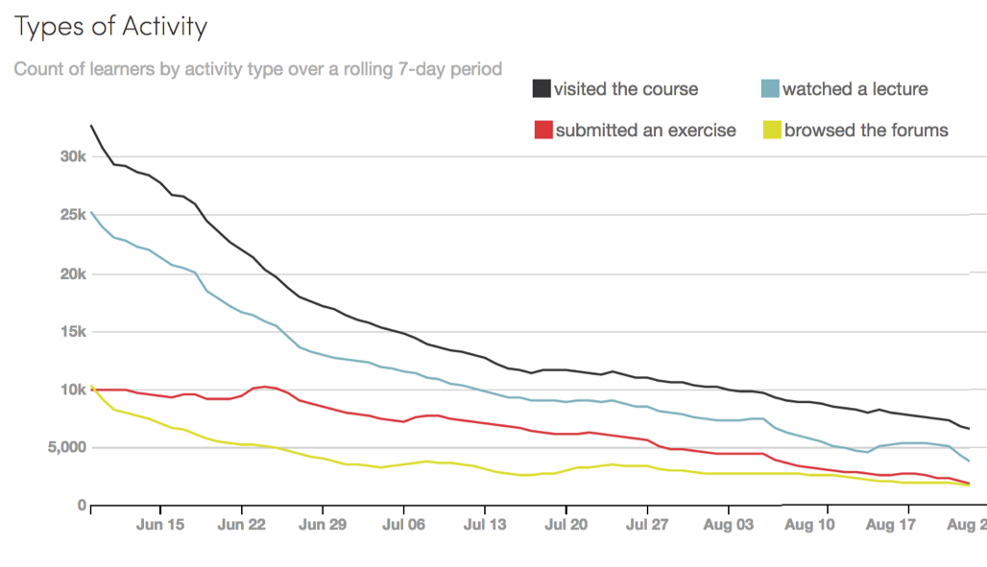

Slide 26
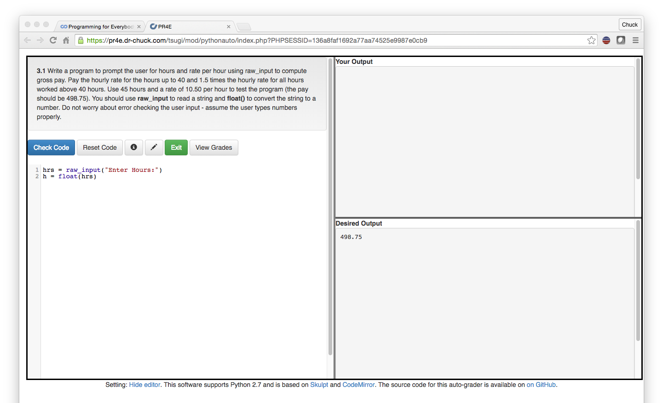
IMS Learning Tools Interoperabilirty
www.tsugi.org

Slide 27

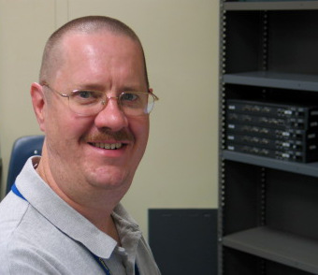
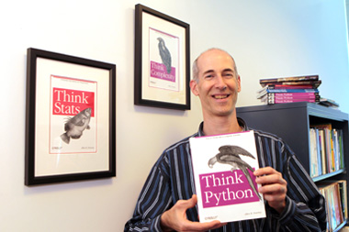
A Free Book
www.pythonlearn.com
Notes:
Average about 400/month

Slide 28






Open Educational Resources

Slide 29
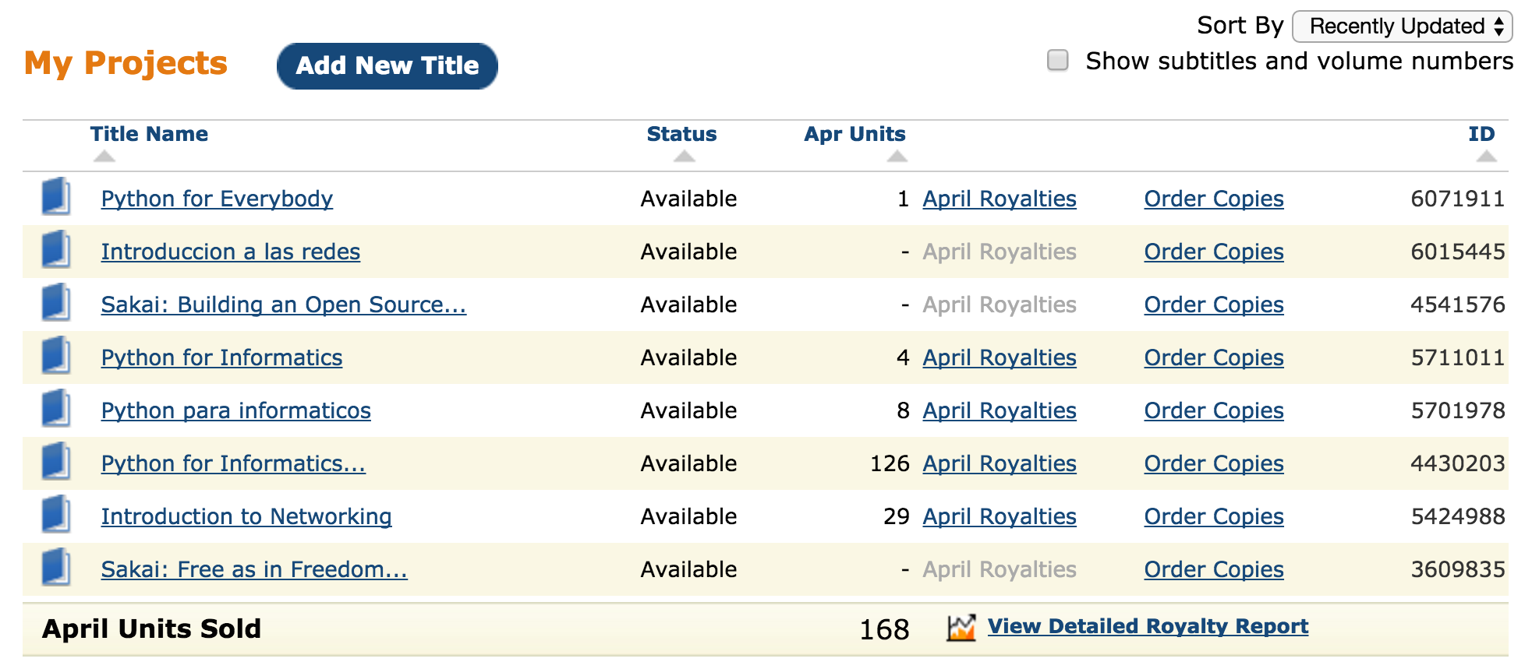
Amazon CreateSpace

Slide 30

https://youtu.be/4hIwl_8hmq8

Slide 31
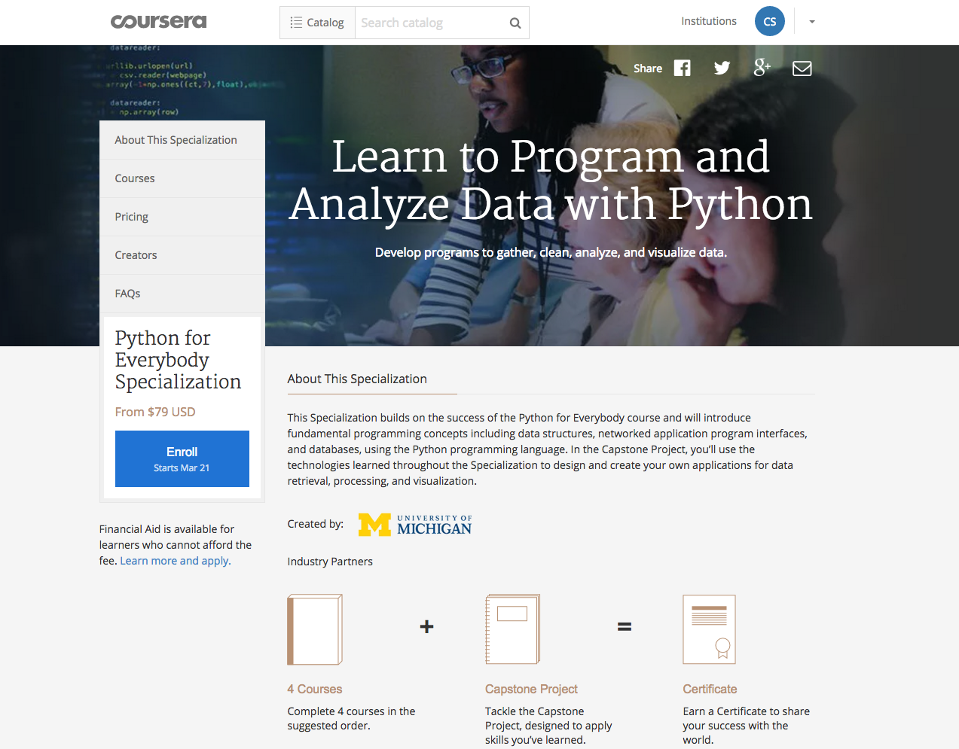
2015

Slide 32
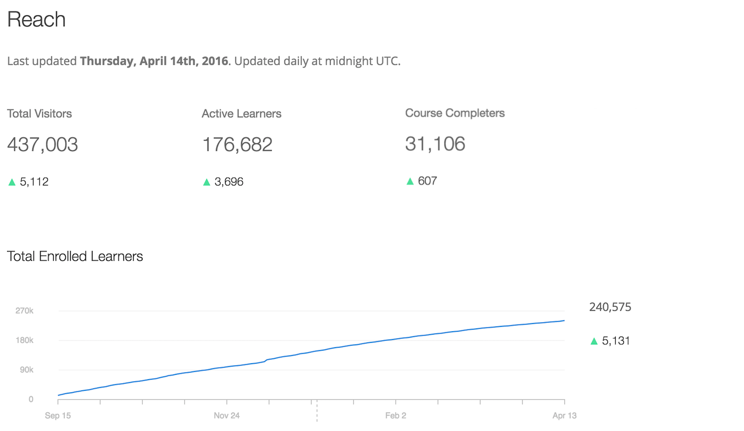
Programming for Everybody (Getting Started with Python)
A 5-week source with a new cohort starting every three weeks.

Slide 33
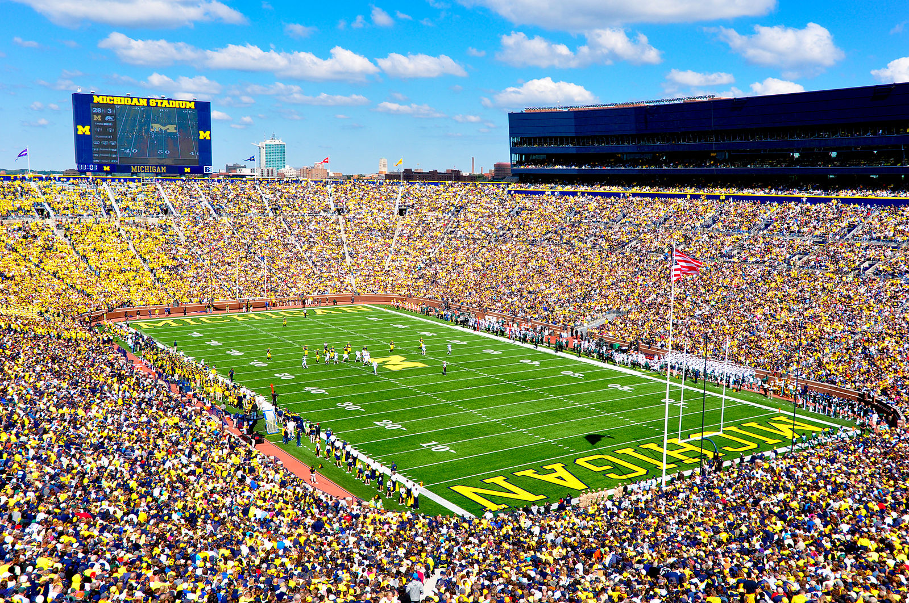
https://commons.wikimedia.org/wiki/File:Michigan_Stadium_Sept_17,2011.jpg

Slide 34
Learn to Program and Analyze Data with Python
Four 5-week courses plus a capstone with a new cohort starting every three weeks.
1
2
3
4
5
1
2
3
4
5
1
2
3
4
5
1
2
3
4
5
1
2
3
4
5
Capstone

Slide 35
MOOC Strategy and Tactics
Beware of "Experts"

Slide 36
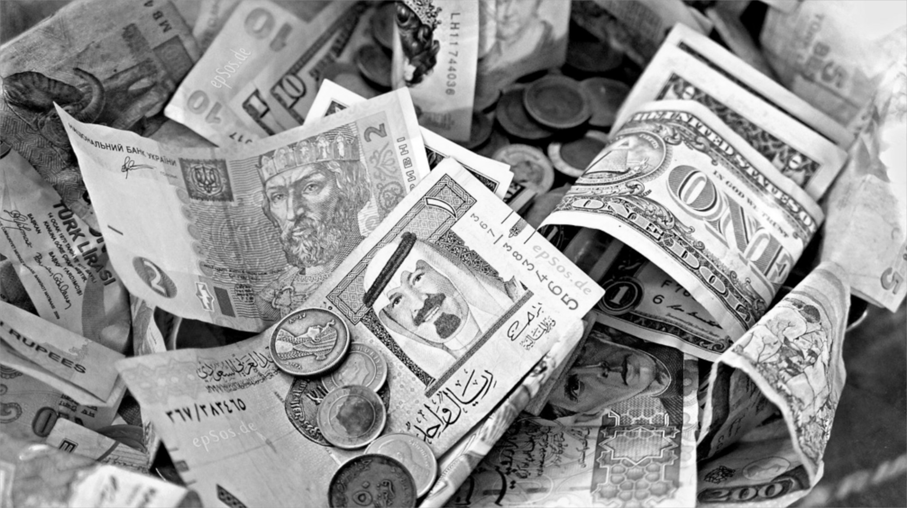
LETS MAKE
MORE MOOCS!
https://commons.wikimedia.org/wiki/File:Exchange_Money_Conversion_to_Foreign_Currency.jpg

Slide 37
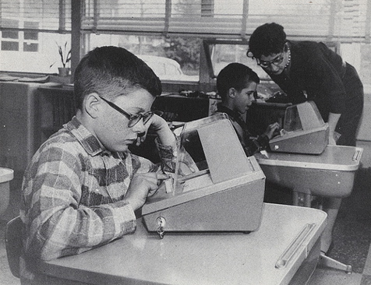
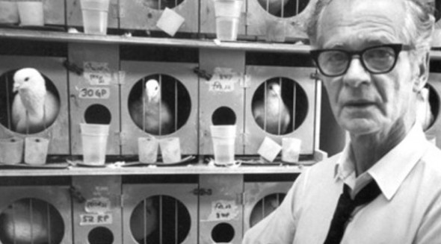

http://afflictor.com/tag/b-f-skinner/

Slide 38
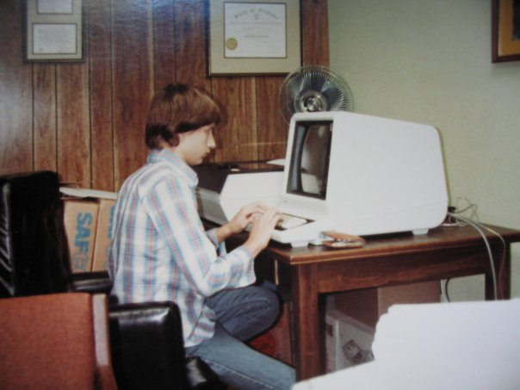
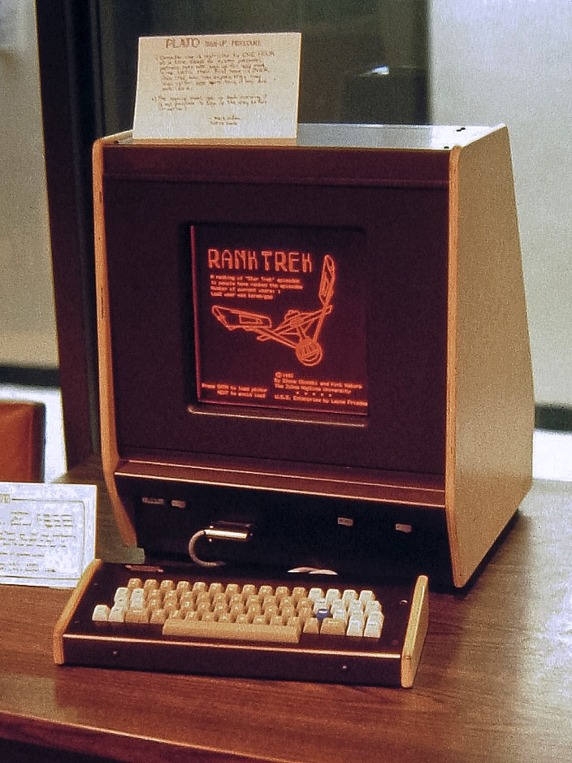
https://en.wikipedia.org/wiki/PLATO_(computer_system)

Slide 39
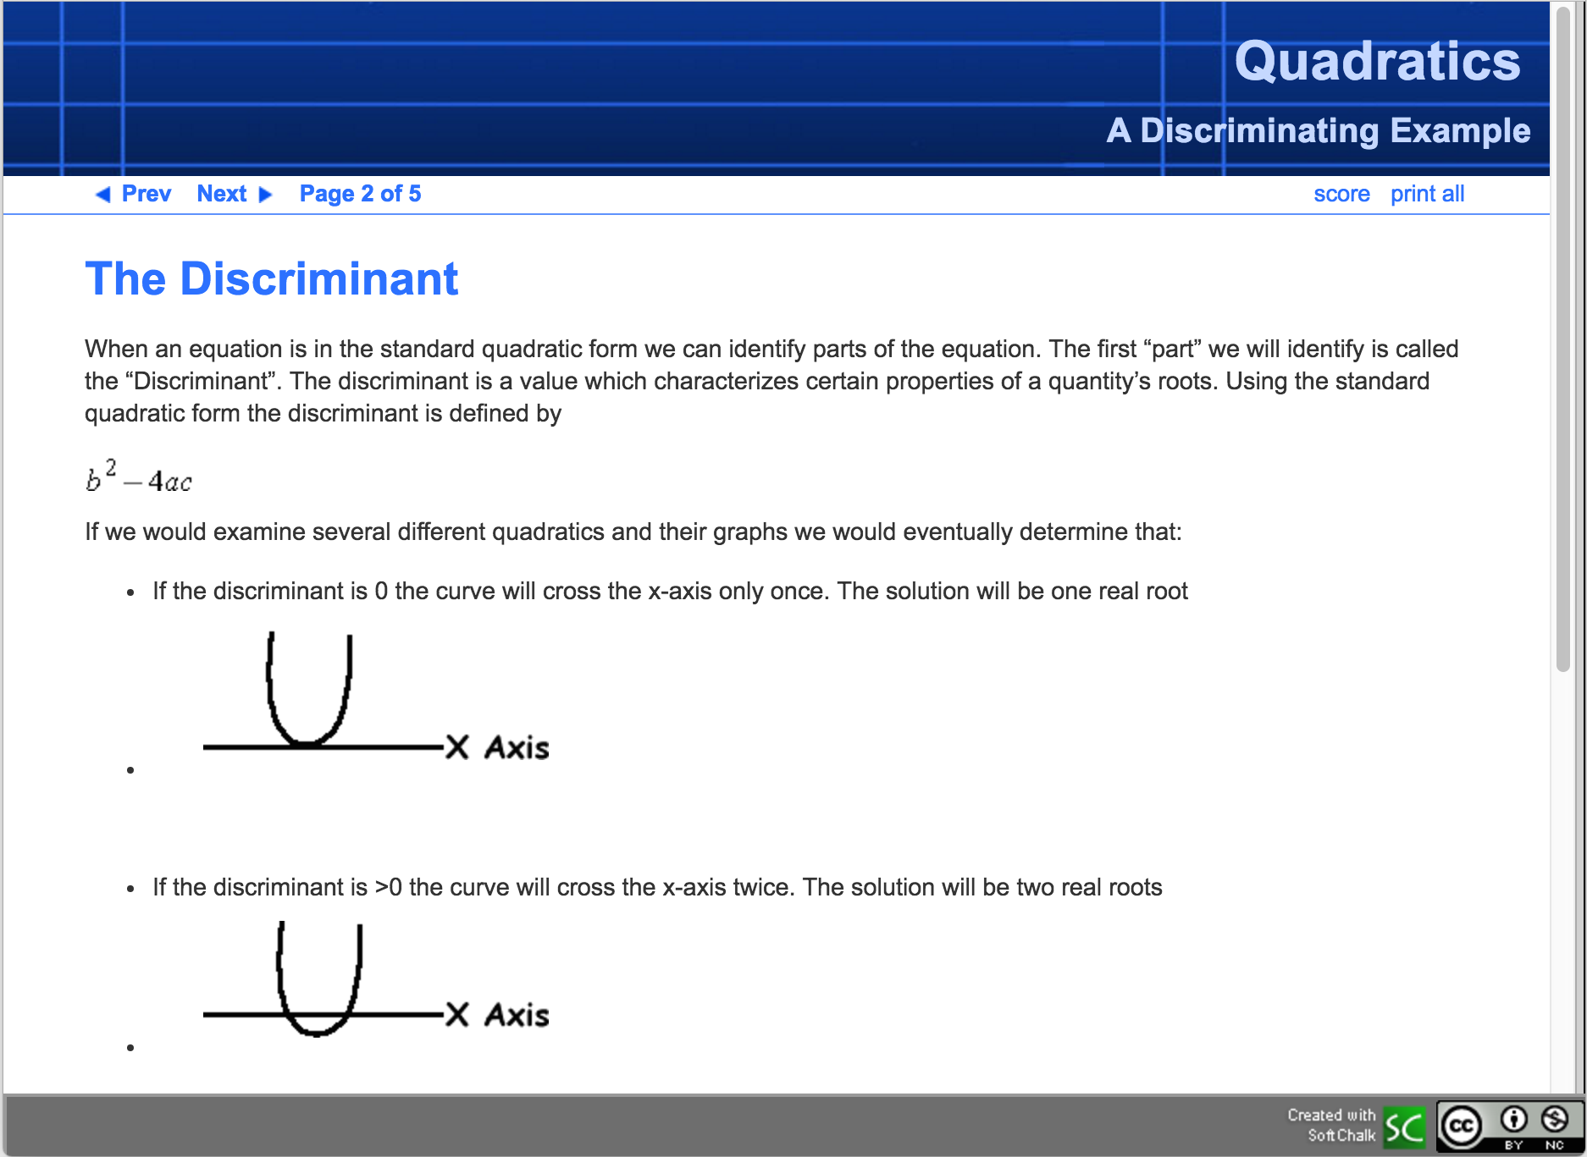
https://www.softchalkcloud.com/lesson/serve/ZKClnbpWDNG6iv/html

Slide 40
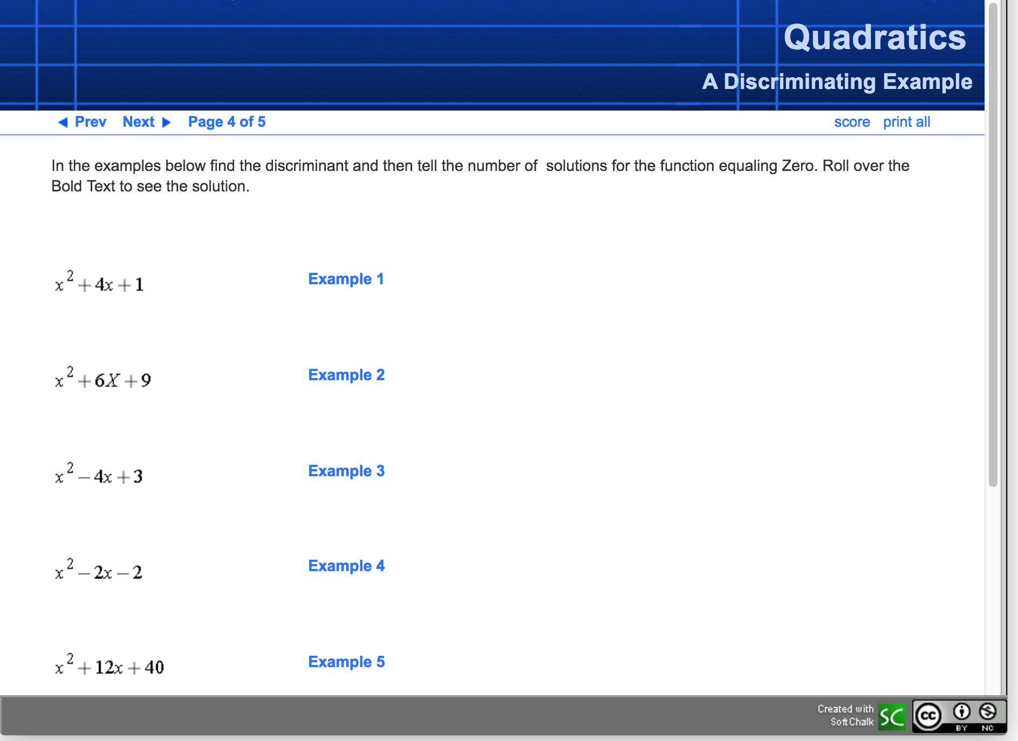
https://www.softchalkcloud.com/lesson/serve/ZKClnbpWDNG6iv/html

Slide 41
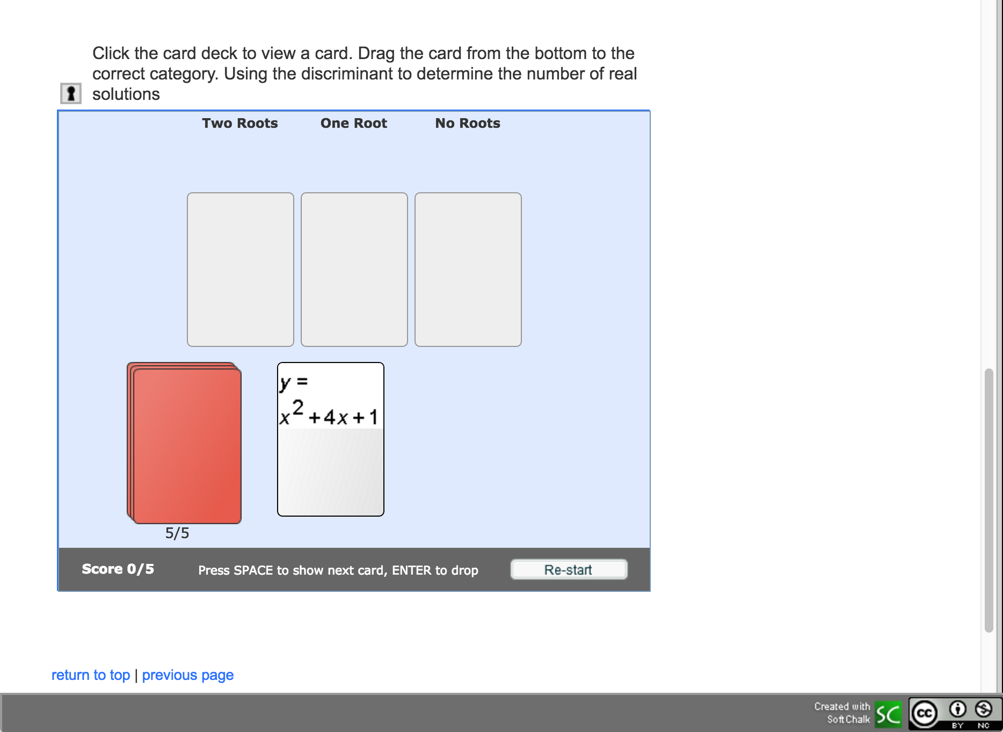
https://www.softchalkcloud.com/lesson/serve/ZKClnbpWDNG6iv/html

Slide 42
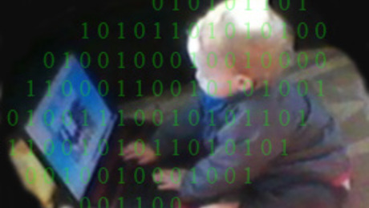
http://www.columbia.edu/~rsb2162/bigdataeducation.html

Slide 43
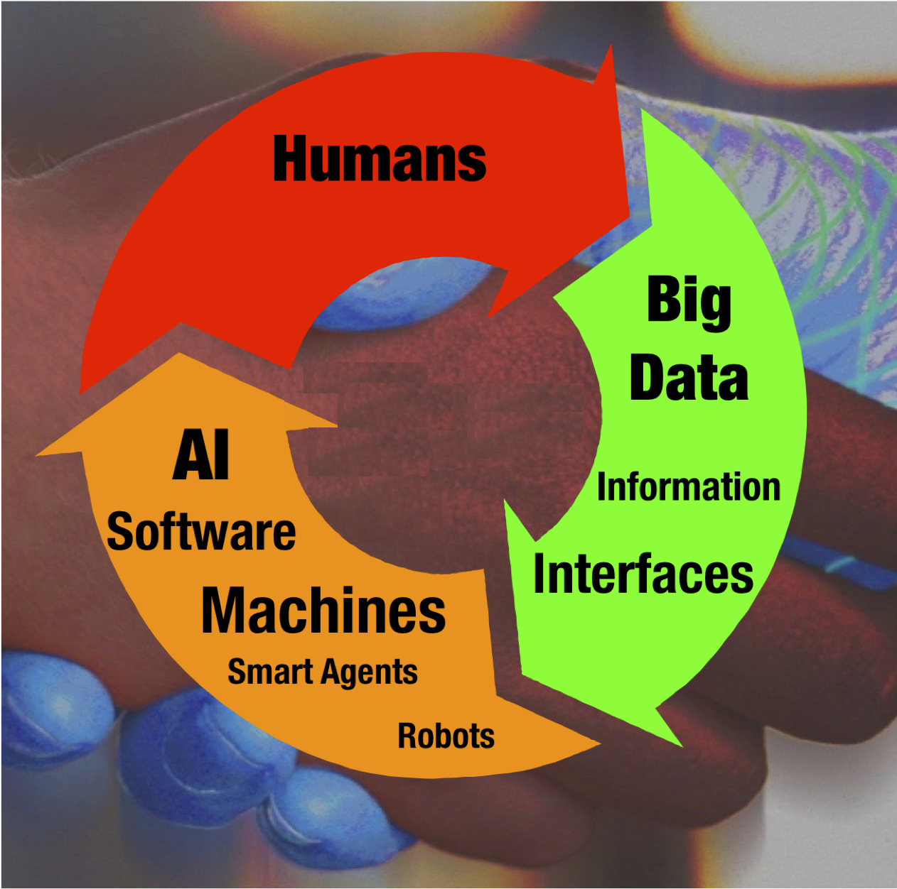
Education

Slide 44
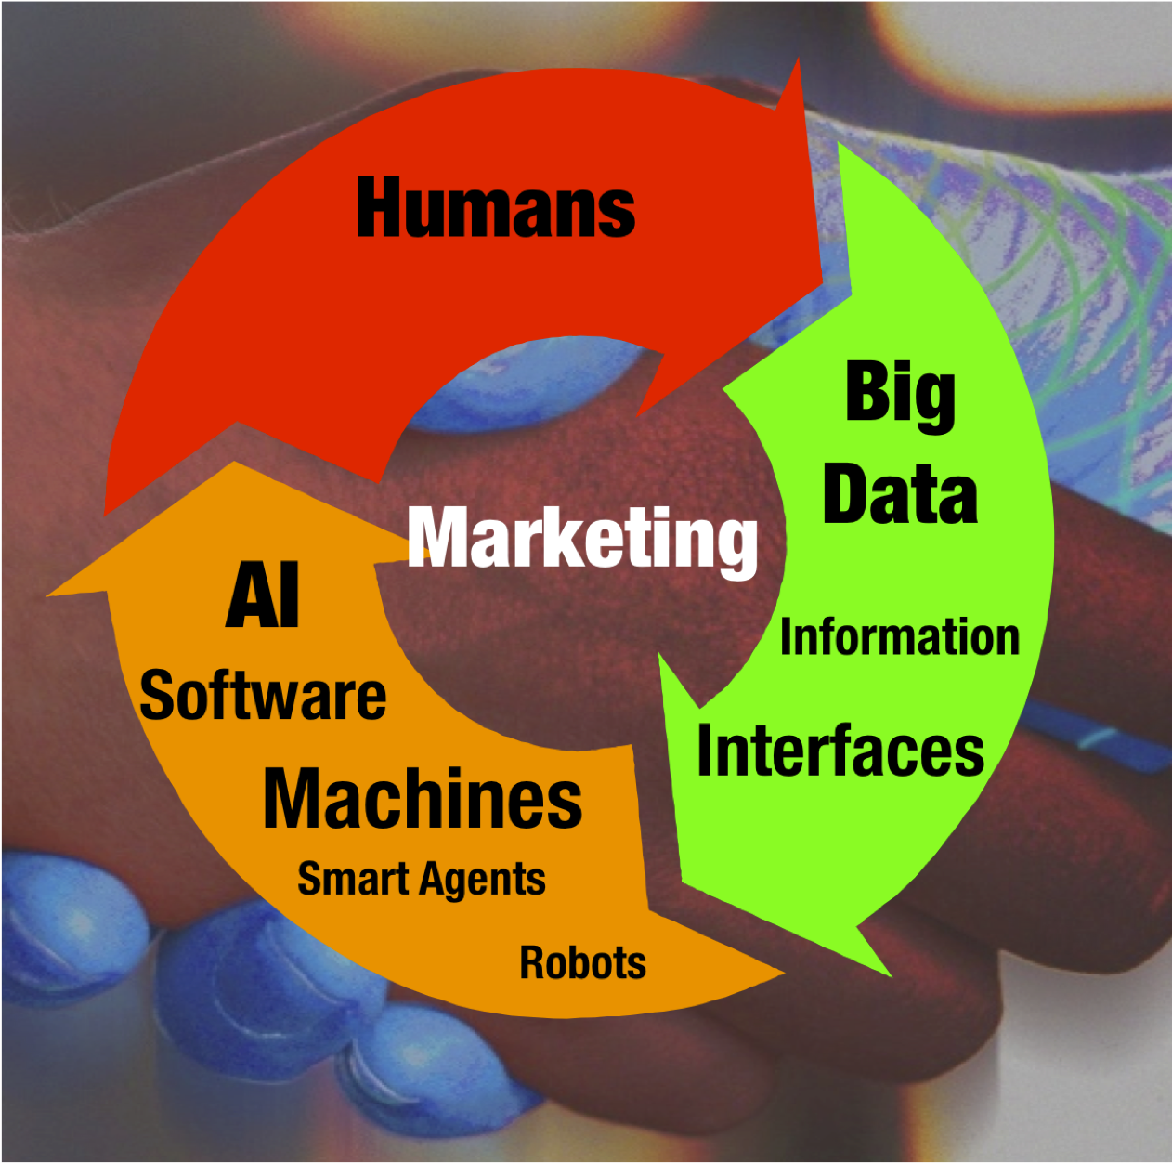
http://www.futuristgerd.com/category/communications-marketing/big-data/

Slide 46
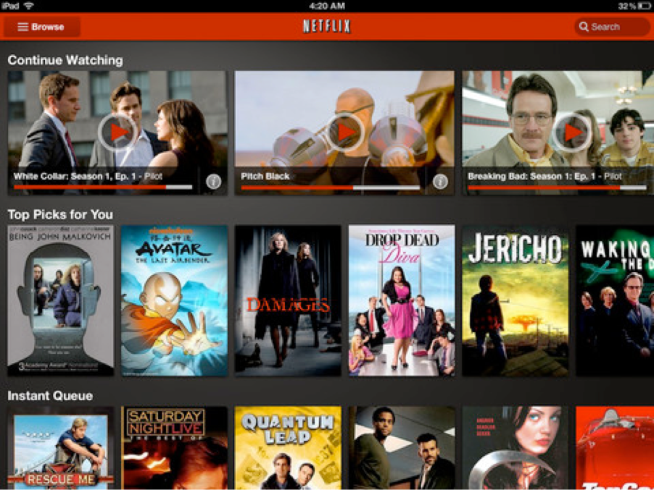
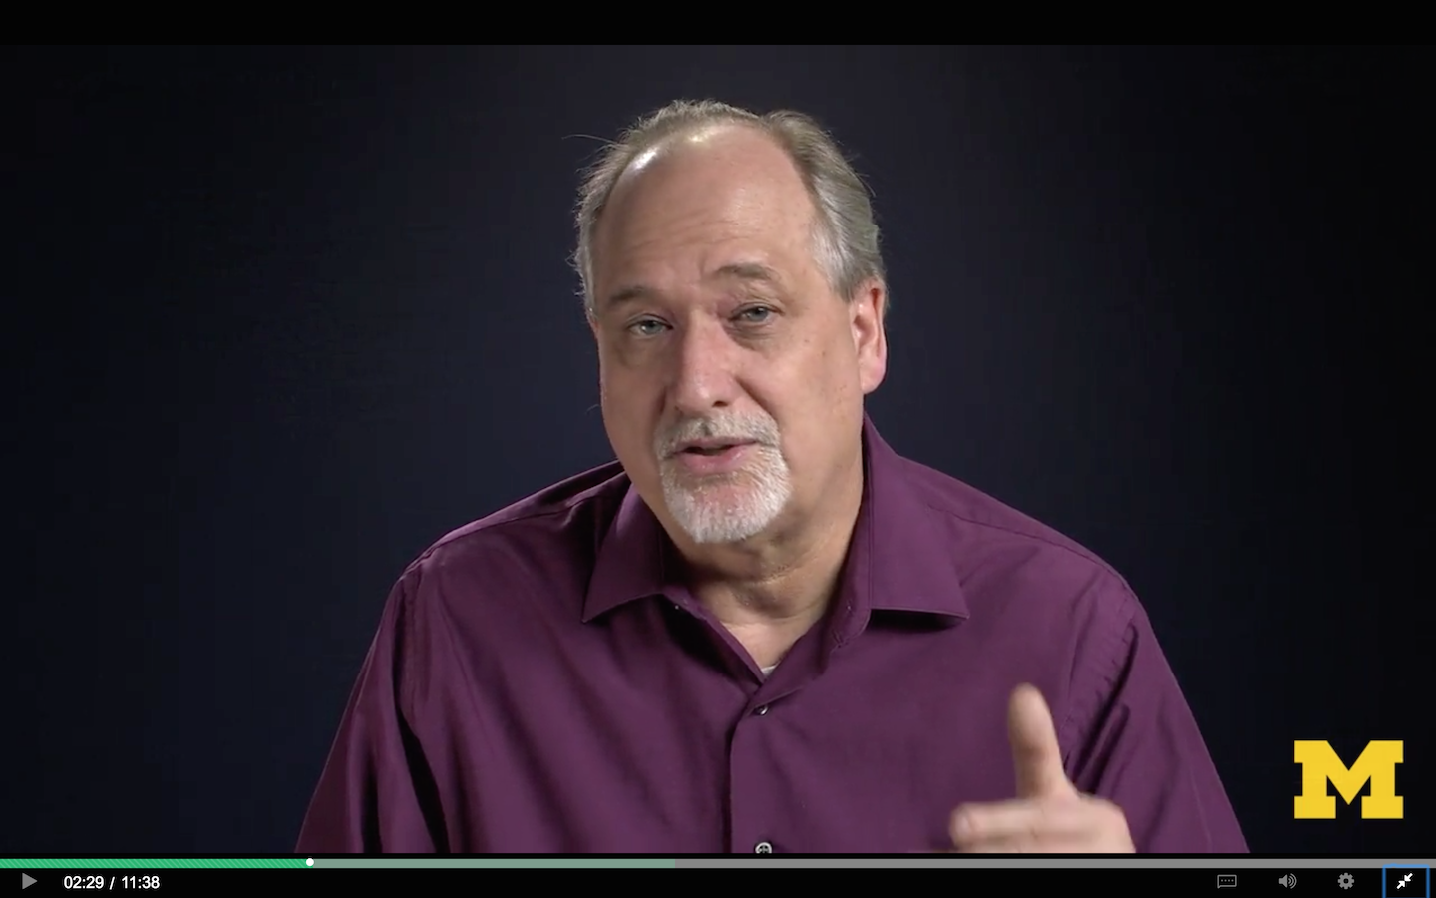

Slide 47
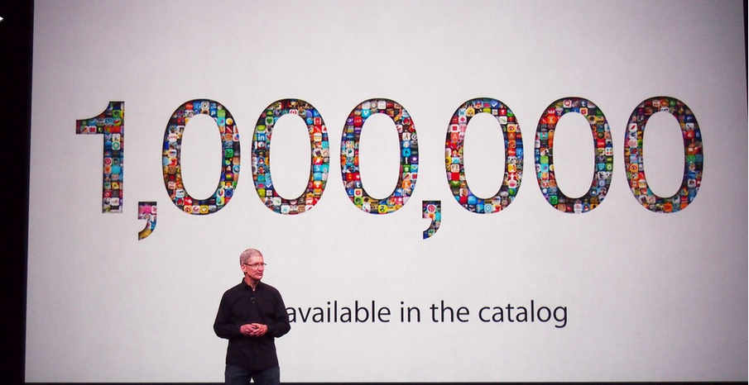
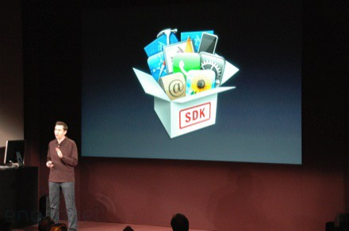
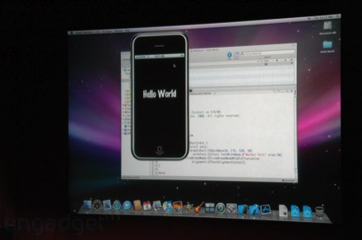
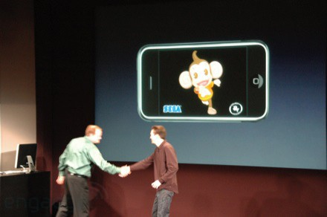
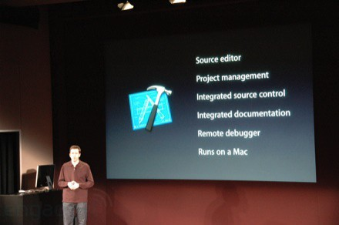
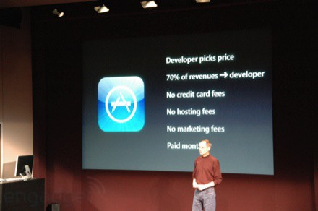

March 6, 2008 iPhone SDK Press Conference

Slide 48

www.tsugi.org

Slide 49
Who, What, When, How?
https://commons.wikimedia.org/wiki/File:Exchange_Money_Conversion_to_Foreign_Currency.jpg

Slide 50


https://commons.wikimedia.org/wiki/File:Michigan_Stadium_Sept_17,2011.jpg

Slide 51
Bachelors Degree
Masers Degree
H
I
G
H
S
C
H
O
O
L
1
2
3
4
W
O
R
K
1
2
3
4
1
2
3
4
1
2

Slide 52
Bachelors Degree
Masers Degree
H
I
G
H
S
C
H
O
O
L
???
1
2
3
4
W
O
R
K
1
2
???
3
4
1
2
3
4
???
1
2

Slide 53
Bachelors Degree
Masers Degree
H
I
G
H
S
C
H
O
O
L
1
2
3
4
W
O
R
K
MOOC
MOOC
1
2
MOOC
MOOC
3
4
1
2
3
4
1
2
2
MOOC
MOOC

Slide 54

Thanks

